Slide 1


Slide 2

Toyota Motor Corporation is a Japanese multinational automotive manufacturer .
It is one of the world's largest automotive manufacturer.
World's market leader in sales of hybrid electric vehicles, and one of the largest companies to encourage the mass-market adoption of hybrid vehicles across the globe.

Slide 3
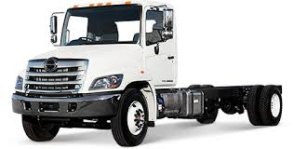
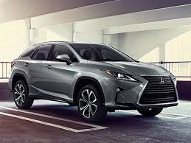
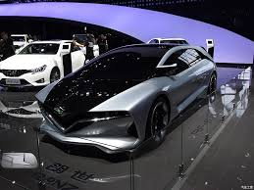
Toyota Motor Corporation produces vehicles under five brands, including the Toyota brand, Hino, Lexus, Ranz, and Daihatsu
Hino
Lexus
Ranz

Slide 4
Milestones
In 2000 - 1st hybrid electric gasoline car ‘The Prius’
In 2002 - When 2nd generation Prius car hit show rooms,there were 10k pre-orders.
Its strategy behind 2nd Gen Prius is to build an environmental friendly car.
Notes:
Environmenta friendly here is to reduce energy consumption,green house gas emission rates, and smo

Slide 5
Offers a full line of cars from family sedans to sport utility vehicles to trucks to minivans.
Different price points from lower cost Scions to mid priced Camrys to luxury Lexus.

Slide 6
What have been key success factors for Toyota?
Product Differentiation features
Service Differentiation features

Slide 7
Product and Service Differentiation features
Customization
Reliability
Product mix
Segmentation

Slide 8
Other Factors
Continuous Improvement
Customer Satisfaction
Quality Products
Unique production System
Respect For people

Slide 9
Where Toyota is vulnerable
Rapid changes in the market for automobiles due to environmental or government changes
Rapid changes by competitors

Slide 10
What should marketers watch out for
External changes to automobile market
Environmental regulations
Governmental regulations
Changes in customer attitude and preferences
Consumption system
Customer value hierarchy

Slide 11
Recommendations to senior marketing executives
Don’t rest on past success .
Target markets.
Customer value hierarchy.

Slide 12
What Toyota Should do with their marketing??
Core benefit
Basic product
Expected product
Augmented product
Potential product

Slide 13


Slide 14
Team
Venkatesh Yadav 14ME161
Sai Teja 14IT216
Shiva Shankar 14IT218
Santosh 14MN14
Sai Kumar 14MN42
Yuva Simha 14MT25

Slide 15


